Slide 1
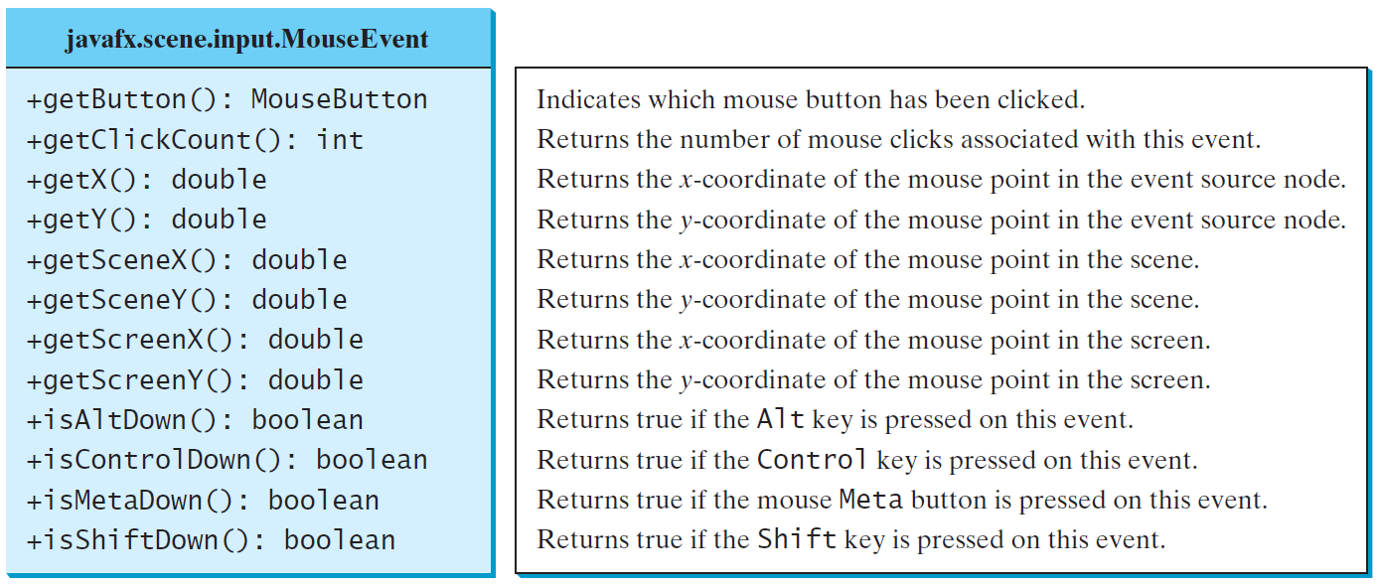
MouseEvent
A MouseEvent is fired whenever a mouse button is pressed, released, clicked, moved, or dragged on a node or a scene.
MouseEventDemo
Run

Slide 2
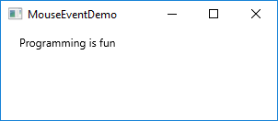
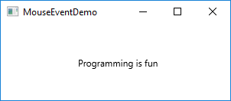
// Move the text with the mouse clicked
import javafx.application.Application;
import javafx.stage.Stage;
import javafx.scene.Scene;
import javafx.scene.layout.Pane;
import javafx.scene.text.Text;
public class MouseEventDemo extends Application {
@Override
public void start(Stage primaryStage) {
Pane pane = new Pane();
Text text = new Text(20, 20, "Programming is fun");
pane.getChildren().addAll(text);
text.setOnMouseDragged(e -> {
text.setX(e.getX());
text.setY(e.getY());
});
Scene scene = new Scene(pane, 300, 100);
primaryStage.setTitle("MouseEventDemo");
primaryStage.setScene(scene);
primaryStage.show();
}
public static void main(String[] args) {
launch(args);
}
}
29

Slide 3
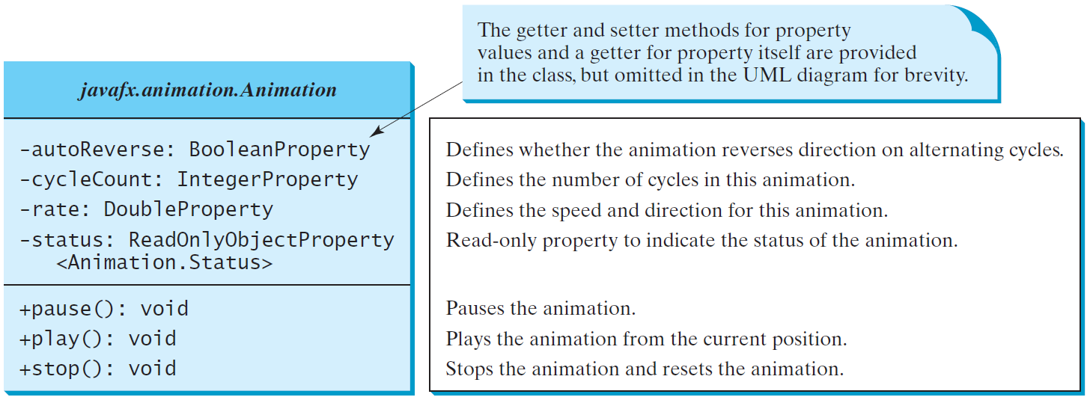
Animation
JavaFX provides the Animation class with the core functionality for all animations.
Notes:
You can use the constant Timeline.INDEFINITE to indicate an indefinite number of cycles.
status -> Animation.Status.PAUSED, Animation.Status.RUNNING, Animation.Status.STOPPED

Slide 4
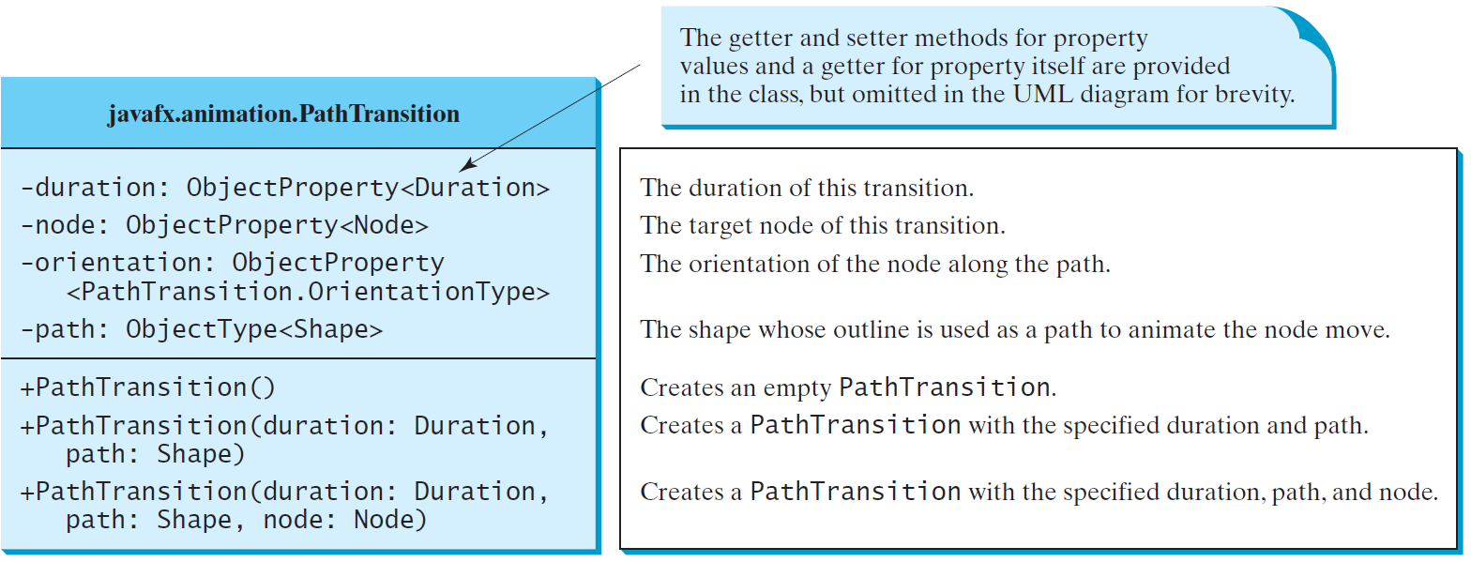
PathTransition
The PathTransition class animates the moves of a node along a path from one end to the other over a given time.
PathTransitionDemo
Run
FlagRisingAnimation
Run
Notes:
First, show the codes for FlagRisingAnimation on Eclipse IDE and run it.
Secondly, show the codes for PathTransitionDemo on Eclipse IDE and run it.

Slide 5
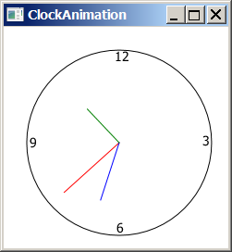
Clock Animation
ClockAnimation
Run

Slide 6
import javafx.application.Application;
import javafx.stage.Stage;
import javafx.animation.KeyFrame;
import javafx.animation.Timeline;
import javafx.event.ActionEvent;
import javafx.event.EventHandler;
import javafx.scene.Scene;
import javafx.util.Duration;
public class ClockAnimation extends Application {
@Override // Override the start method in the Application class
public void start(Stage primaryStage) {
ClockPane clock = new ClockPane(); // Create a clock
// Create a handler for animation
EventHandler<ActionEvent> eventHandler = e -> {
clock.setCurrentTime(); // Set a new clock time
};
// Create an animation for a running clock
Timeline animation = new Timeline(
new KeyFrame(Duration.millis(1000), eventHandler));
animation.setCycleCount(Timeline.INDEFINITE);
animation.play(); // Start animation
// Create a scene and place it in the stage
Scene scene = new Scene(clock, 250, 250);
primaryStage.setTitle("ClockAnimation"); // Set the stage title
primaryStage.setScene(scene); // Place the scene in the stage
primaryStage.show(); // Display the stage
}
public static void main(String[] args) {
launch(args);
}
}

